Slide 1
Working Capital Estimation and Financing

Slide 2
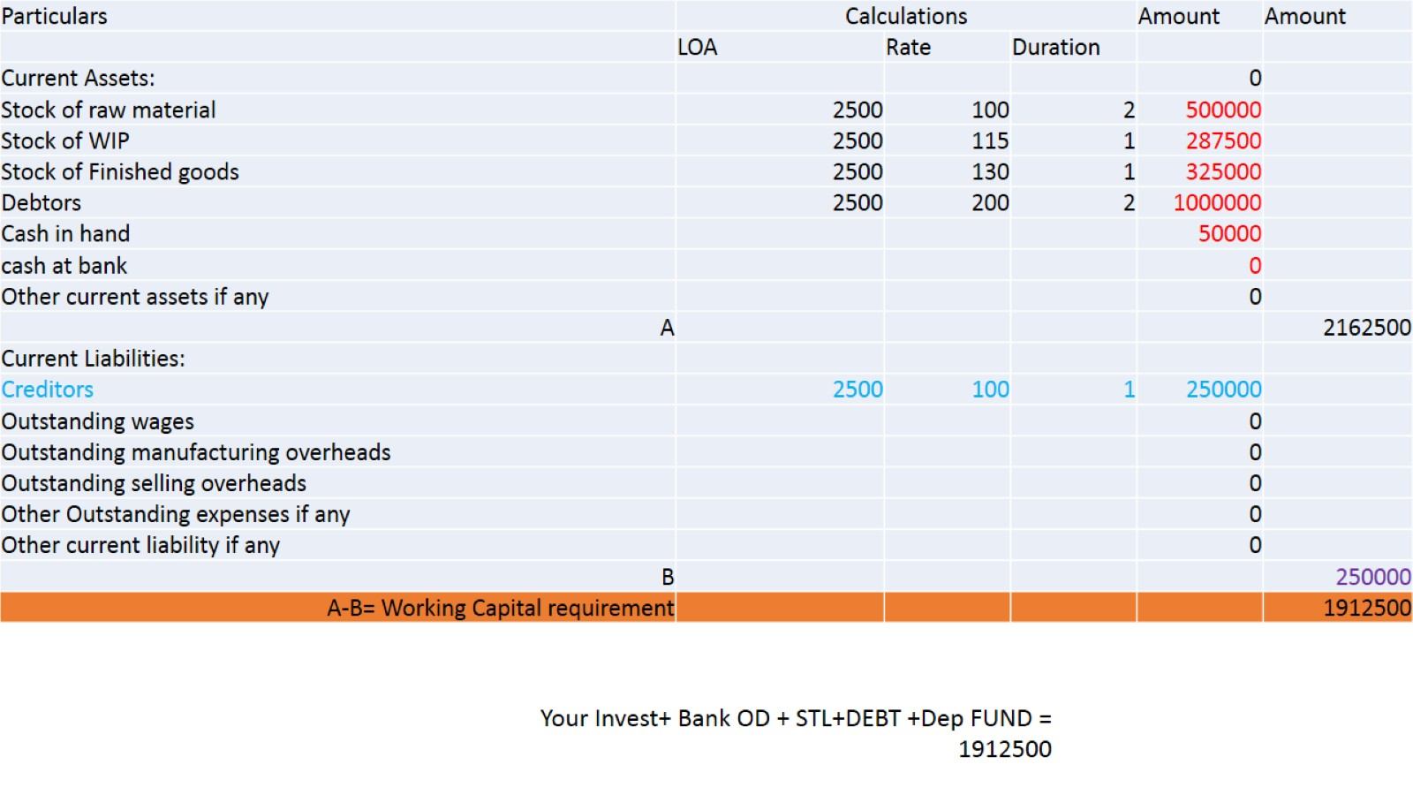

Slide 3
Tandon committee recommendations

Slide 4
Tandon committee recommendations

Slide 5
Major recommendations of the Tandon committee were as follows:

Slide 6
Methods of Lending

Slide 7
Three methods of calculating MPBF

Slide 8
Other Parts

Slide 9
References

Slide 10
Thank You

